Slide 1
Sacroiliitis project
15/01/17 meeting

Slide 2
The method
Segmentation:
Segmentation of the hips area
Segmentation of the Joint
Selection of points of interest
Extraction of patches
Classification:
Bag of features
SVM

Slide 3
1.1. Segmentation of the hips
Almost always successful
~5 samples failed (out of ~150), all of which had a resolution of >2.5 mm axial distance
Even with this resolution, most samples succeed (35/40)

Slide 4
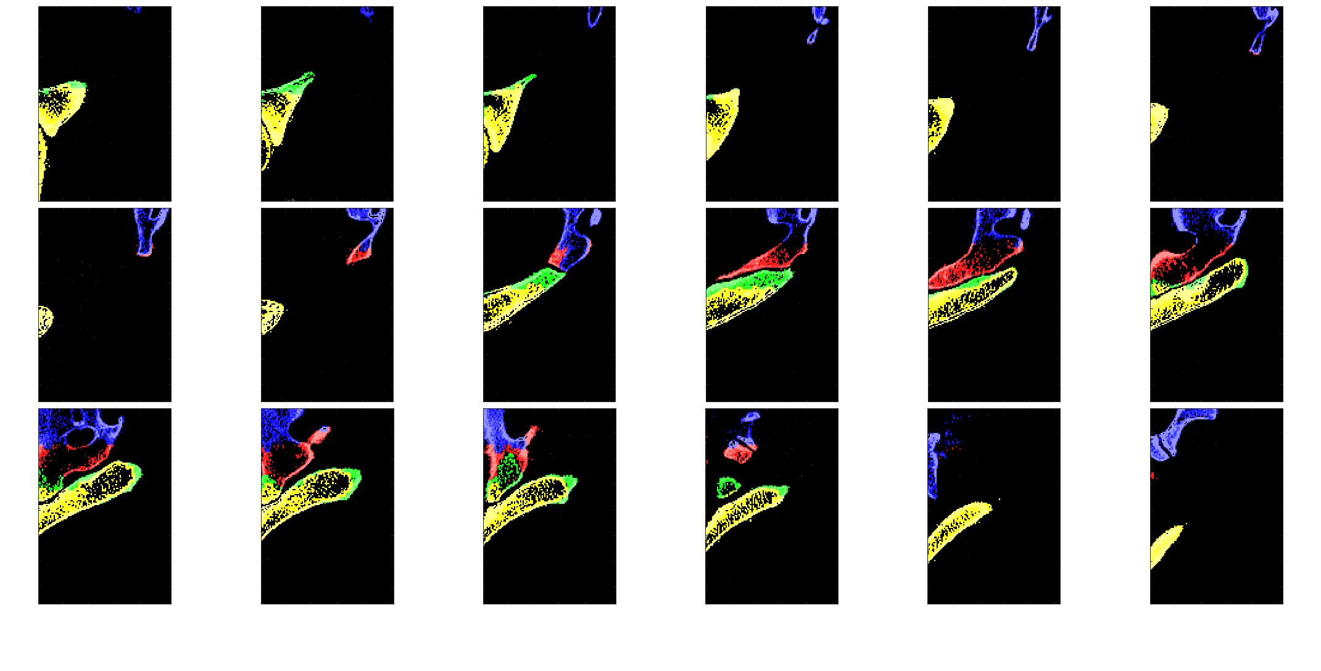
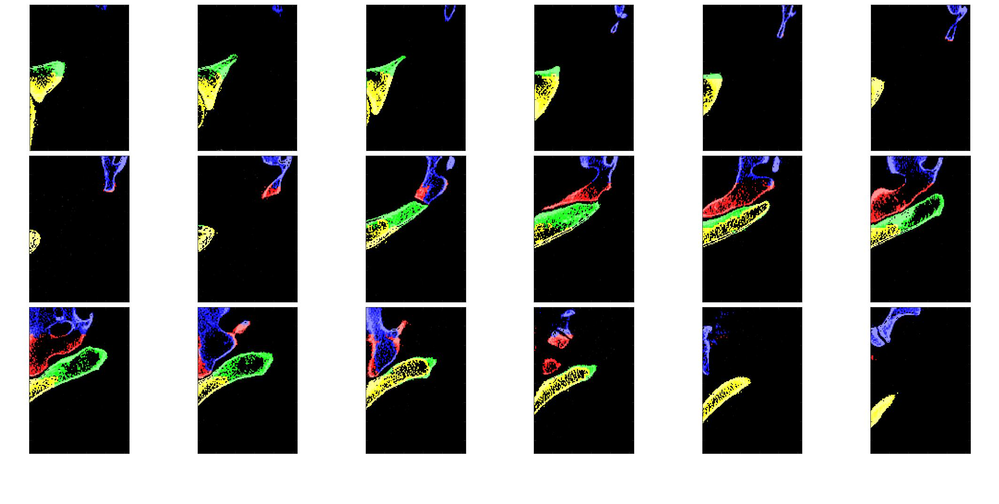
1.2. Segmentation of the joint
We went from this:
To this:

Slide 5
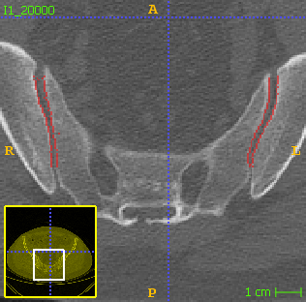
1.2. Segmentation of the joint – cont.
Which gives us a good border:

Slide 6
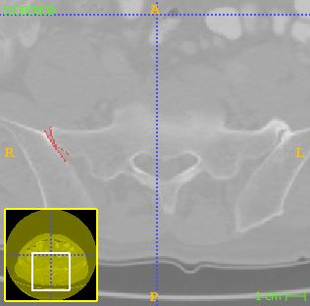
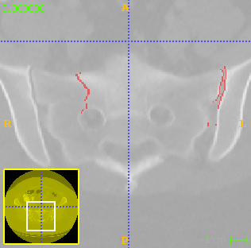
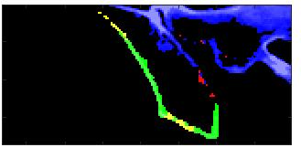
1.2. Segmentation of the joint – cont.
There are still failures:

Slide 7
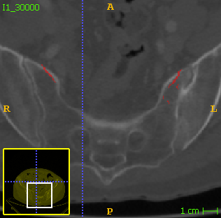
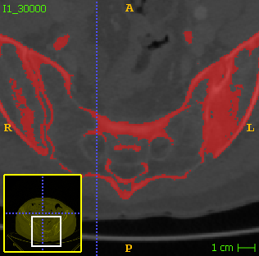
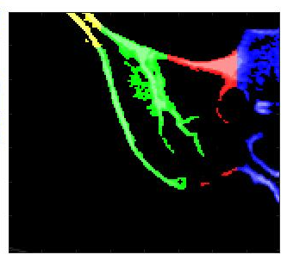
1.2. Segmentation of the joint – cont.

Slide 8
1.3. Selection of points of interest
We would like to try to adjust the “window” for selecting these points in a way that will give good points even upon receiving bad border
Haven’t tried it yet

Slide 9
And this is where I got for now, more fun to come ☺

